Slide 1
Lecture themes
Writting embedded code
Business models

Slide 2
Writing embedded code

Slide 3
Writing embedded code
In most cases, writing code for an embedded platform is no different to that of desktop or server.
However, there are a few differences, and it is worth bearing them in mind.
One of the big differences between embedded systems and conventional computing platforms is resource availability.
The aim with IoT devices is to take the idea of automated or self-maintenance further.

Slide 4
Writing embedded code
Issues to be considered
Memory management
Performance and battery life
Libraries
Debugging

Slide 5
Memory management
Types of memory
  ROM- information stored in the chips is hard-coded at the chips’ creation and can only be read afterwards.
  Flash- can store without requiring any power, and without the disadvantage of being unchangeable forever.
  RAM- requires power to retain its contents, but the speed of update is comparable with the time taken to read from it.
Notes:
ROM
Read-only memory refers to memory where the information stored in the
chips is hard-coded at the chips’ creation and can only be read afterwards.
This memory type is the least flexible and is generally used to store only the
executable program code and any data which is fixed and never changes.
Originally, ROM was used because it was the cheapest way of creating
memory, but these days it has no cost advantage over Flash chips, so their
greater flexibility means that pure ROM chips are all but extinct.
Flash
Flash is a semi-permanent type of memory which provides all the advantages
of ROM—namely, that it can store information without requiring any
power, and so its contents can survive the circuit being unplugged—without
the disadvantage of being unchangeable forever more. The contents of flash
memory can be rewritten a maximum number of times, but in practice it is
rare that you’ll hit the limits. Reading from flash memory isn’t much different
in speed as from ROM or RAM. Writing, however, takes a few processor
cycles, which means it’s best suited to storing information that you want to
hold on to, such as the program executable itself or important data that has
been gathered.
RAM
Random-access memory trades persistence for speed of access. It requires
power to retain its contents, but the speed of update is comparable with the
time taken to read from it (particularly when compared to flash memory).
As a result it is used as the working memory for the system—the place where
things are stored while being processed.
Systems tend to have a lot more persistent storage than they do RAM, so it
makes sense to keep as much in flash memory as is possible. Obviously, the
program code itself lives in flash. You can also provide hints to the compiler
(the program which turns your source code into the machine code that the
processor understands) to help it place as much as possible of the running
program into flash.
If you know that the contents of a variable won’t ever change, it is better to
define that variable as a constant instead. In the C and C++ programming
languages (which are commonly used in embedded systems), you do this by
using the const keyword. This keyword lets the compiler know that the
variable doesn’t need to live in RAM because it will never be written to—only
read from. Using constants this way can be a big saving if you have any large
lookup tables or other big data structures such as fonts or bitmaps. Even text
strings for debugging purposes can take up a noticeable amount of space. It’s
much better to get this storage out of RAM and into flash.

Slide 6
Memory management …
Move out of RAM and into flash if possible:
  Define const instead of variable (read fast from flash) ….
  Using constants, big saving can be achieved in large- lookup tables or other data structures.
  It’s much better to get this storage out of RAM and into flash.
  The syntax in c- https://www.geeksforgeeks.org/constants-in-c-cpp/
Notes:
If you know that the contents of a variable won’t ever change, it is better to
define that variable as a constant instead. In the C and C++ programming
languages (which are commonly used in embedded systems), you do this by
using the const keyword.

Slide 7
Memory management …
Move out of RAM and into flash …
  In Arduino, using the macro F(...) tells the system that this string is from a “flash” memory- replace Serial.println(“This string will be stored in RAM”); with:
        void setup(void)
        {
        Serial.begin(19200);
        }
        void loop(void)
        {
        Serial.println(F(“This one will be in flash”));
        }
  Constants https://www.arduino.cc/reference/en/language/structure/further-syntax/define/
Notes:
If you know that the contents of a variable won’t ever change, it is better to
define that variable as a constant instead. In the C and C++ programming
languages (which are commonly used in embedded systems), you do this by
using the const keyword.

Slide 8
Memory management …
Make the most out of RAM
  Mostly we have a few kilobytes of RAM.
  So, it is easy to fill the RAM and cause the device to misbehave.
  Be able to handle datasets which are bigger than the entire available memory for the system!
  This means that, in XML, test for well formed (looks like an XML file) rather than validity (conforms to a given schema)
Notes:
In a deterministic model, you need to take a different tack. Rather than
allocate space for the entire page, you set aside space to store the important
information that you’re going to extract and also a buffer of memory that
you can use as a working area whilst you download and process the page.
Rather than download the entire page into memory at once, you download it
in chunks—filling the buffer each time and then working through that
chunk of data before moving on to the next one.

Slide 9
Memory management
Organising RAM: Stack
Stack is easy for the processor to keep track of where things are and how much space is being used.
It is useful for items which are short-lived and in constant use.
Global variables are allocated first on the stack, variables defined in functions follow.
So, the maximum memory usage on the stack depends on the execution path that code can take through your code.

Slide 10
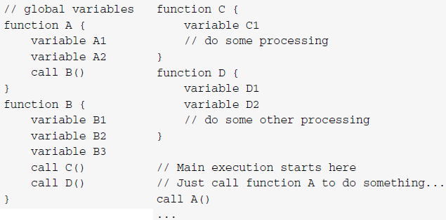
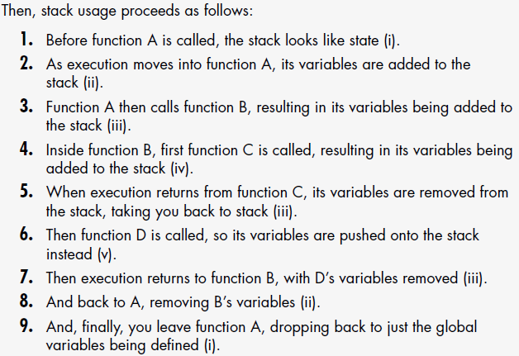
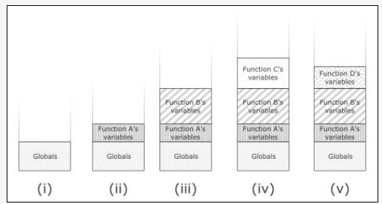
Memory management
Organising RAM: Stack …

Slide 11
Memory management
Organising RAM: Heap
The heap, in comparison, enables to allocate chunks of memory and keep them around for as long as needed.
The heap allocates like the seats in a train- as groups of people arrive, it directs them to the next available block of seats.
When there are insufficient continuous seats for incoming group, they sit in the rear seats of the train- it soon gets out of memory!
Notes:
Out of memory!
The second problem is more subtle: though
you theoretically have enough free seats for the next group of passengers, those
free seats are spread across the train and aren’t available in a continuous block
of free seats. This last situation is known as memory fragmentation.

Slide 12
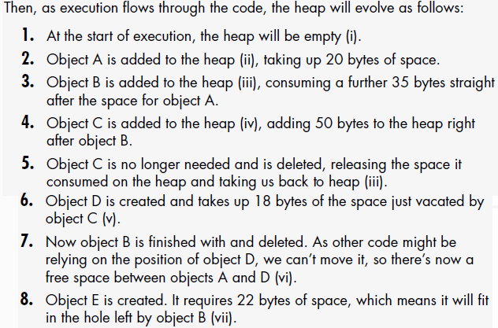
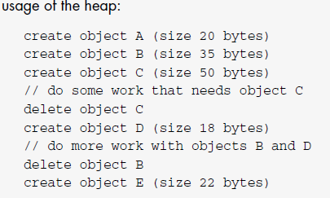
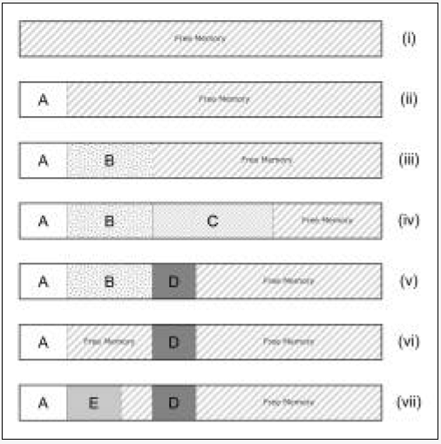
Memory management
Organising RAM: Heap …

Slide 13
Memory management
Organising RAM: Stack versus Heap
It is recommended that systems having small RAM use stack instead of heap- but can still run out of memory due to stack overflow.
Stack overflow occurs in a deeply nested recursive routine in which it could outgrow the available fixed space.
So, it is advisable to avoid using recursive algorithms in an embedded system by reworking it as an iterative one.

Slide 14
Memory management …
Recursive
int GetSum (int num, int sum)
{
if(num==1) return sum;
return GetSum (num-1,sum+num);
}
Iterative
int GetTotal (int num, int sum)
{
for (i=1; i<=num; i++)
sum += i;
return sum;
}
Converting recursion into iteration- more examples

Slide 15
Performance and battery life
Performance and battery life tend to go hand in hand- what is good for one is usually good for the other.
Biggest power-saving comes from the hardware design- e.g., turning off modules of the system when not in use.
Additionally, the quicker the code finishes running, the sooner the hardware can go to sleep.
One of easiest ways for code efficiency is to move to an event-driven model rather than polling for changes.

Slide 16
Performance and battery life …
It is also helpful if there is a possibility to reduce the amount of data being processed.
A service API might provide options which reduce how much information it sends to the client.
This could be done by writing a service to sit between the device and the proper service API- shim service.
Notes:
If it would make sense to restrict the data, but the
existing API doesn’t provide that possibility, you always have the option of
writing a service of your own to sit between the device and the proper API
(known as a shim service). The shim service has all the processing power and
storage available to a web server and so can do most of the heavy lifting.
After this, it just sends the minimum amount of data across to be processed
in your embedded system.
For instance, Bubblino talks directly to Twitter and downloads a full set of
search results as XML each time it checks for new messages. All this data is
processed and finally reduced down to a single number—how many new
tweets it finds.

Slide 17
Performance and making efficient code
Place the more likely to happen code in the if clause.
In some scenarios it is quicker to insert a value into the code as a plain number rather than to load that value from variable.
Use pointer or a reference to the initial buffer of the Ethernet protocol passed from layer to layer instead copying values.
If required, the system’s memory copying and moving routines (such as memcpy and memmove) are usually more efficient.
Notes:
if something is true
The more likely to happen code goes here
else
The less likely path of execution should go here
This is particularly an
issue in protocol work, where data is initially read into a packet buffer
for the Ethernet layer, say, and then passed up to the IP layer, then the
TCP layer, followed by the HTTP code, and finally the application layer.
A naive approach would copy the data at each step, as you unpack the
relevant protocol headers. This approach could result in all the application
data being copied five times as it travelled up the stack. A better
approach would be to have a pointer or a reference to the initial buffer
passed from layer to layer instead. In addition to the length of the data,
you may need to store an offset into the buffer to show where the
relevant data starts, but that’s a small increment in complexity to greatly
reduce how much data is copied around.

Slide 18
Libraries
We are accustomed to use array of libraries/frameworks (to ease life) in conventional software development.
Here, pull parsing library for a language or data format of choice – no resource limit, tools available, etc.
However, embedded systems are resource-limited to just pull in mainstream-operating system libraries and code.
So, start from scratch or find one that’s already written with microcontroller limitations in mind.
Notes:
When developing software for server or desktop machines, it is accustomed to use a large array of libraries and frameworks to make life easier.

Slide 19
Libraries …
Example- LightWeight IP (lwIP)
  lwIP is a full TCP/IP stack which runs in low-resource conditions.
  It requires only tens of kilobytes of RAM and around 40KB of ROM/flash.
  The official Arduino WiFi shield uses a version of this library.
  http://savannah.nongnu.org/projects/lwip/
Notes:
◾ uIP: uIP, or micro IP (http://en.wikipedia.org/wiki/
UIP_%28micro_IP%29), is a TCP/IP stack targeted at the smallest
possible systems. It can even run on systems with only a couple of
kilobytes of RAM. It does this by not using any buffers to store incoming
packets or outgoing packets which haven’t been acknowledged. This
means that some of the retransmission logic for the TCP layer bleeds
into the application code, making your code more tightly coupled and
more complex. It’s quite common on Arduino systems which don’t use
the standard Ethernet shield and library, such as the Nanode board,
using the Ethercard port for AVR (https://github.com/jcw/
ethercard).
◾ uClibc: uClibc (http://www.uclibc.org/) is a version of the
standard GNU C library (glibc) targeted at embedded Linux systems. It
requires far fewer resources than glibc and should be an almost drop-in
replacement. Changing code to use it normally just involves recompiling
the source code.
◾ BusyBox: Although not really a library, BusyBox (http://www.
busybox.net/) is a collection of a host of useful UNIX utilities into a
single, small executable and a common and useful package to provide a
simple shell environment and commands on your system.

Slide 20
Libraries …
Example- BusyBox
  It is a collection of useful UNIX utilities in single, small executable and a common and useful package.
  It provides a simple shell environment and commands on your system.
  It runs in environments like- Linux, Android, and FreeBSD
  http://www.busybox.net/

Slide 21
Debugging
Bug finding is one of the difficult parts of writing software.
It is even more challenging in embedded systems because of fewer ways for code inspection.
IoT complicates it further by introducing custom electronic circuits and communication with servers across a network.
Debugging in embedded systems is more primitive- no IDEs.
Debugging an embedded platform running fully featured operating system (e.g., Linux) is easier than a microcontroller.

Slide 22
Debugging … in embedded systems
Systems such as embedded Linux usually have support for remote debugging with utilities such as gdb, the GNU debugger.
Another way to get access to desktop-grade debugging tools is to emulate your target platform on the desktop.
However, the further the target hardware is from a desktop the harder it is to write software subsystems for the emulator.
The most common debugging technique is to write strings to a logging system- e.g., logging the amount of free space at startup.
Notes:
gdb
Systems such as embedded Linux usually have support for remote debugging
with utilities such as gdb, the GNU debugger (www.gnu.org/software/
gdb/). This utility allows you to attach the debugger from your desktop
system to the embedded board, usually over a serial connection but
sometimes also over an Ethernet or similar network link. Once it is attached,
you then have access to a range of capabilities similar to desktop debugging—
the ability to set breakpoints, single-step through code, and inspect
variables and memory contents.
Emulated platform on the desktop
Because you are then running the code
on your desktop machine, you have access to the same capabilities as you
would with a desktop application. The downside of this approach is that you
aren’t running it on the exact hardware that it will operate on in the wild.
However, the further the target hardware is from a desktop the harder it is to write software subsystems for the emulator which accurately reflect the behaviour of the electronics.

Slide 23
Debugging … in embedded systems …
TCP/IP stacks offer basic capabilities even without a dedicated debug interface on the network.
Example, if you know IP address of a device and it responds a ping network utility, it can be inferred that some part is functioning.
Packet sniffers such as wireshark also enable to see what is happening at the network.
If all else fails, the debugging tool of last resort is to use a hardware test: flashing an LED.

Slide 24
Business models

Slide 25
Business model
What is a business model?
  A business model describes the rationale of how an organization- creates, delivers, and captures value- in contexts like economic, social, or cultural.
  Wikipedia
A business model:
  Is the basis for going from planning to running one
  It is a solution to monitor (as canvas) survival of company

Slide 26
Business model
The model should provide answers to key questions:
  What should we deliver?
  Who are the customers?
  Who are partners and who are competitors?
  How should we sell?
  How should we deliver?
  How should we get paid?
  How should we make a profit?

Slide 27
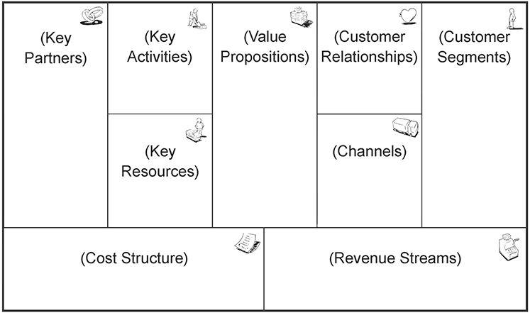
Business model …
Business Model Canvas

Slide 28
Business model …
A business plan is a systematic review of a business idea- that provides a written summary of the following aspects of the business:
  Knowledge and prerequisites
  Business idea
  Products/services
  Target groups/market choice
  Selected strategies
  Market potential
  Organization
  The economy of the venture

Slide 29
Business model …
In general:
  For the vast majority, the most important point is how to make (enough) money?
  To start own company, you must have a good business model and plan!
  NB: only 3 out of 10 start-up businesses survive the first five years!

Slide 30


Funding
  Do you know of schemes that can help with financing start-ups/new products?
  Industrial, Financial & Business Management (IFBM) funding!
  Tax deductions for small/startup business.
  Reimbursement of expenses- like paid salaries, you get 20% off.
Notes:
Pilot-T received 20 applications totaling NOK 120 million in this call. The Research Council and Innovation Norway have divided the applications among themselves according to criteria stated in the call. Applicants will be notified in the near future of further processing of the application.

Slide 31

Funding …
Other sources:
  Investors AllianceVenture
  Incubators StartupLabs
  Crowdfunding- Kickstarter, Gofundme, Indiegogo, etc.
  Borrow money? What amount? Can I afford to lose?

Slide 32
Funding …
What variants do you know to make money on products?
  Selling the item?
  Are there other ways to make a profit?
  Subscription fees for software, extra cost for optional/customization, etc.
  Selling expertise in the form of consulting hours

Slide 33
Points for discussion
Why does writing embedded code require a different approach than conventional code?
What are the important issues to consider in writing embedded code?
What is a business model?
Draw a business-model canvas for an ideal IoT service/ intelligent product. Write at least one for each of the components of the canvas. Post the notes on menti to be viewed and discussed by other classmates.

Slide 34

Next themes
Guest lecture on robotics
Follow-up discussions

